Slide 1
PH3915
September 2023
Simple Discounting, Compounding and Decision Criteria

Slide 2
Simple Compounding/Discounting
Let, P = the principal (beginning amount)
r = the interest rate
V_{n} = the value of the amount at the end of year n,
Assume, P = $100 (e.g. a bond ) and r = 10%
Then, V₁ = P + r · P = P(1 + r) = $110
V₂ = V₁(1 + r) = P(1 + r)(1+r)= P(1 + r)² = 121
V₆ = V₅(1 + r) = P(1 + r)(1 + r)(1 + r)
(1 + r)(1 + r) = 177
or, P(1 + r)⁶ = V₆
V_{n} = V_{n-1}(1 + r) = P(1 + r)^{n}
General formula for simple compounding is
V_{n} = P(1 + r)^{n}
Discounting formula reverses this process and is
P = V_{n}/(1 + r)^{n}

Slide 3
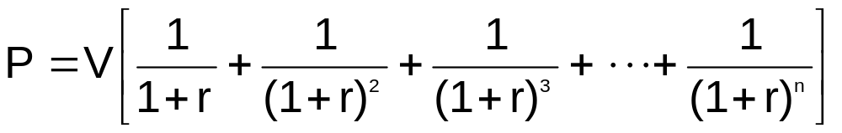
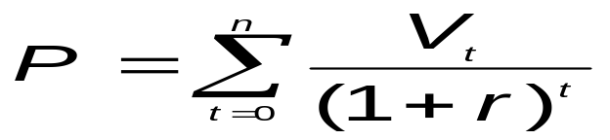
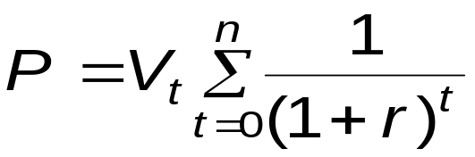
Annuities
If V_{n} = the value of the amount at the end of year n, and
If V₁ = V₂ = V₃ = … = V_{n} , we have a series of of
fixed payments called an annuity.
When this is the case, the present value formula for discounting [ P = V_{n} / (1 + r)^{n}] , is transformed into
or the present discounted value of an annuity.
Note: This is equivalent to
Where all V_{t} are equal.
Or,

Slide 4
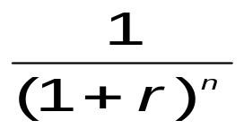
Table A: Simple Discounting Example
P = V_{n} / (1+r)^{n} = V₅ / (1.09)⁵
= $500/(1.09) (1.09) (1.09) (1.09) (1.09)
= $500/1.5386 = $324.97
Alternatively, using the table, where r = 9%, and n=5 years we find 0.6499. Simply multiple 0.6499 x 500 = $324.97.
Thus, the table give us
For various r and n values, as 0.6499 = 1/1.5386.

Slide 5
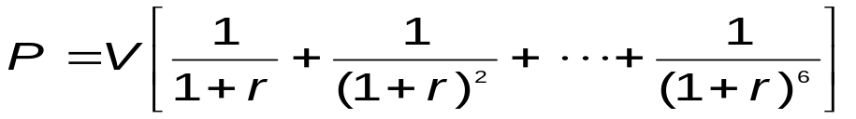
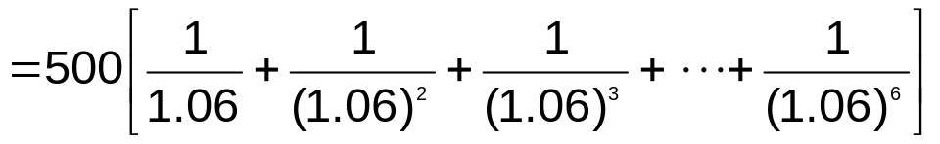
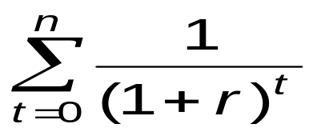
Table B: Present Value of Annuities
= 500 [4.917] = $2,458.50, the present discounted
value of the annuity; i.e, 4.917 is from the table
where, r = 6% and n =6 years.
Thus, table B gives us
As if V = 1.
This value is then multiplied by the real value of V to
yield P.

Slide 6
Problem 1
Assume we have the opportunity to invest in a new activity and we have the following information.
REVENUE |  |  | COSTS
R₀ = $0 | (TODAY) |  | C₀ = $0
R₁ = 100 | (YEAR 1) |  | C₁ = 50
R₂ = 300 | (YEAR 2) |  | C₂ = 200
R₃ = 400 | (YEAR 3) |  | C₃ = 400
R₄ = 100 | (YEAR 4) |  | C₄ = 200
R = 12%
Given P = V_{n}/(1+r)^{n} , find the present value of revenue and then of costs. Determine the present value of profit.

Slide 7
Solution to Problem 1
Use Table A:
R₀ = $0 R₁ = 100 (.8929) = 89.29 R₂ = 300 (.7972) = 239.16 R₃ = 400 (.7118) = 284.72 R₄ = 100 (.6355) = 63.55 $676.72 | C₀ = $0 C₁ = 50= (.8929) = 44.65 C₂ = 200 (.7972) = 159.44 C₃ = 400 (.7118) = 284.72 C₄ = 200 (.6355) = 127.10 $615.91
Profit (discounted) = $676.72 - $615.91 = $60.81

Slide 8
Problem 2
R = 12%
REVENUES | COSTS
R₀ = $0 R₁ = 100 R₂ = 300 R₃ = 500 R₄ = 800 R₅ = 800 R₆ = 800 R₇ = 800 R₈ = 800 R₉ = 800 • • • R₂₀ = 800 | C₀ = $1000 C₁ = 600 C₂ = 600 C₃ = 600 C₄ = 600 C₅ = 700 C₆ = 200 C₇ = 200 C₈ = 200 • • • • C₂₀ = 200
Find the present value of revenues, costs and profits, utilizing Tables A and B.

Slide 9
Solution to Problem 2
R₀ = $0 | C₀ = $1000 (no discounting)
R₁ = 100 (.8929) = 89.29 | C₁ = 600(3.037) = $1822.00 to where, 3,037 is a 4 C₄ year annuity at 12% interest
R₂ = 300(.7972) = 239.16 | C₅ = 700(.5674) = 397.18
R₃ = 500(.7118) = 355.90 | C₆ = 200(6.811) (.5674) = 772.91 to where 6.811 is a 15 year C₂₀ annuity; 0.5674 is the 5 year discount factor at 12%
R₄ = 800(7.120) (.7118) to = 4,054.42 R₀ where, 7.120 is a 17 year annuity at 12% interest, and 0.7118 is the 3 year discount factor at r = 12% | Present value of costs = $3,992
Present value of R = $4,738.76
Present value of profit = $4,738.76 - $3,992.29 = $747.47

Slide 10
Solution to Exercise
Alternative #1:
R₀ = $0 R₁ = 6,000(.9259) = 5555.40 R₂ = 20,000(8.244)(.9259) to = 152,662.39 R₁₅ R₁₆ = 5,000(8.559) (.3152) to = 13,488.98 R₃₀ Present Value = $171,706.77 | C₀ = $100,000 C₁ = 2000(.9259) = 1851.80 C₂ = 5000(.8573)= 4286.50 C₃ = 4000(11.258) (.8573) to = 38,605.93 C₃₂ Scrap Value - 1,000 x 0.0994 = -99.40 Present Value = $144,644.83
Net present value = $27,061.94
Alternative #2:
Net present value = $35,000
Solution: Choose alternative #2

Slide 11
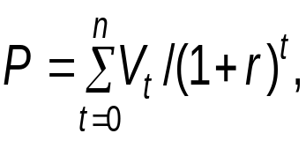
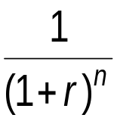
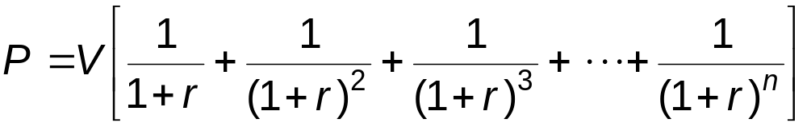
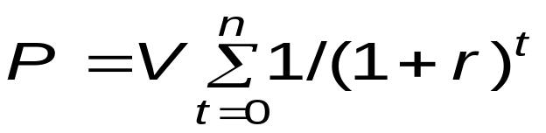
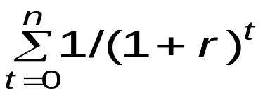
Brief Review
V_{n} = P(1 + r)^{n} , is the simple compounding formula
P = V_{n}/(1 + r)^{n} or
Is the formula for present value (simple) discounting table A calculates
for you.
(2)
or
Is the formula for finding the discounted present
value of an annuity.
Table B calculates
for you.

Slide 12
Compounding/Discounting
Multiple Times per Year
P=Vₙ/(1+r/ₘ)ᵐⁿ
Where, m = number of times per year which we compounͬd n = number of years r = discount rate

Slide 13

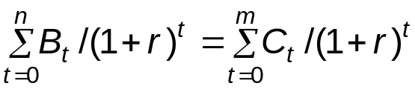
Decision Criteria
1. Net Present Value Rule (NPV):
Formula:
Where A = benefits less costs
r = social discount rate
n = year
The net benefits (benefits less costs) in each period are discounted to the present to yield the NPV, if NPV > 0 → accept project. If NPV < 0→ reject.
When considering mutually exclusive projects, the one with the higher NPV is recommended.
Alternatively, the formula may be stated.

Slide 14
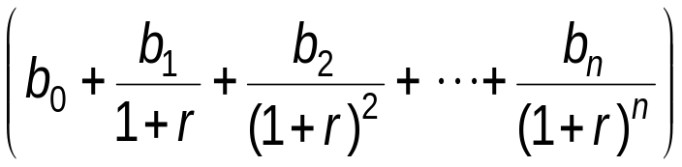
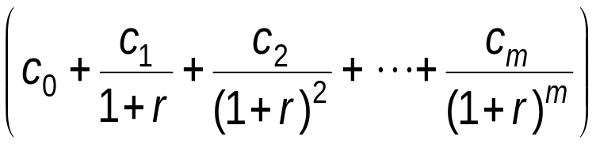
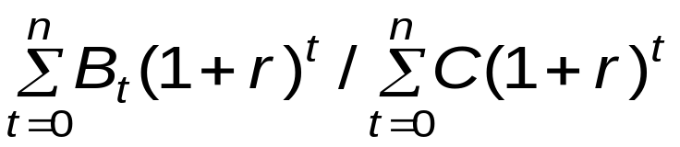
Decision Criteria
2. Benefit – Cost Ratio (B/C):
Formula:
_____________________
Where b = benefits
c = costs
n = years of benefits
m = years of costs
The discounted present value of benefits is divided by the discounted present value of costs. If b/c = > accept project. If b/c = < reject.
When considering mutually exclusive projects, the one with the higher b/c is recommended.
When the NPV and b/c ratios make contradictory recommendations, the NPV rule is superior.

Slide 15

Decision Criteria
3. Internal Rate of Return Rule (IRR):
Formula:
Where A = benefits less cost
I = the internal rate of return
r = the social discount rate
n = years
If r < i = > accept project
If r > i => reject project
The internal rate of return that will reduce the future net benefit stream to zero is calculated and compared to the social discount rate.
Where the decision-criteria conflict, the NPV rule is always superior.

Slide 16
Numerical Example Illustrating Comparison of Decision Rules
Assume Projects 1, 2 & 3 are Mutually Exclusive (only one will be funded)
Basic question: Which project should be funded?
Project 1 |  | Discount Rate
 |  | r = 10% | r = 6%
Decision Rule | Net Present Value | -$56,741 | $29,606
 | Benefit/Cost Ratio | 0.92 | 1.04
Project 2 |  | Discount Rate
 |  | r = 10% | r = 6%
Decision Rule | Net Present Value | $383,500 | $541,767
 | Benefit/Cost Ratio | 1.59 | 1.80
Project 3 |  | Discount Rate
 |  | r = 10% | r = 6%
Decision Rule | New Present Value | $126,478 | $163,721
 | Benefit/Cost Ratio | 2.71 | 3.11

